Slide 1
Hands On: Visual Studio 2012
Greg Chasteen, Technical Account Manager, Siemens PLM Software

Slide 2
Agenda
Create Windows Application
Execute Your Application
Set Form Properties
Layout Your Form
Name Your Controls
Rearranging The Controls
Write code using IntelliSense and code snippets
Write event handler methods
This presentation will mainly use Visual Basic delivered with Visual Studio 2012.

Slide 3
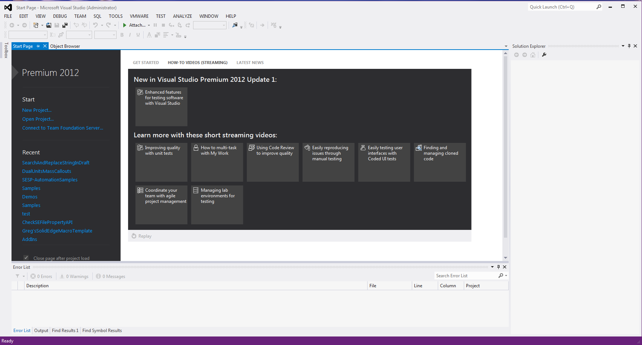
VB 2012
The Integrated Development Environment when you launch VB2012 is shown in the diagram below

Slide 4
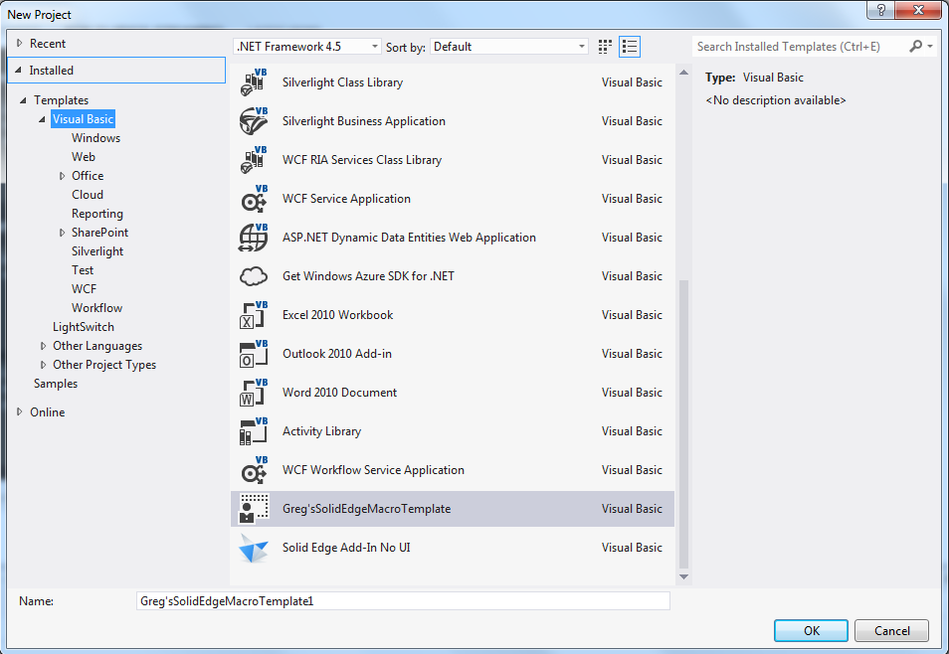
VB 2012
To start a new Visual Studio 2012 project, simply click on New Project to launched The Visual Studio New Project page as shown below:

Slide 5
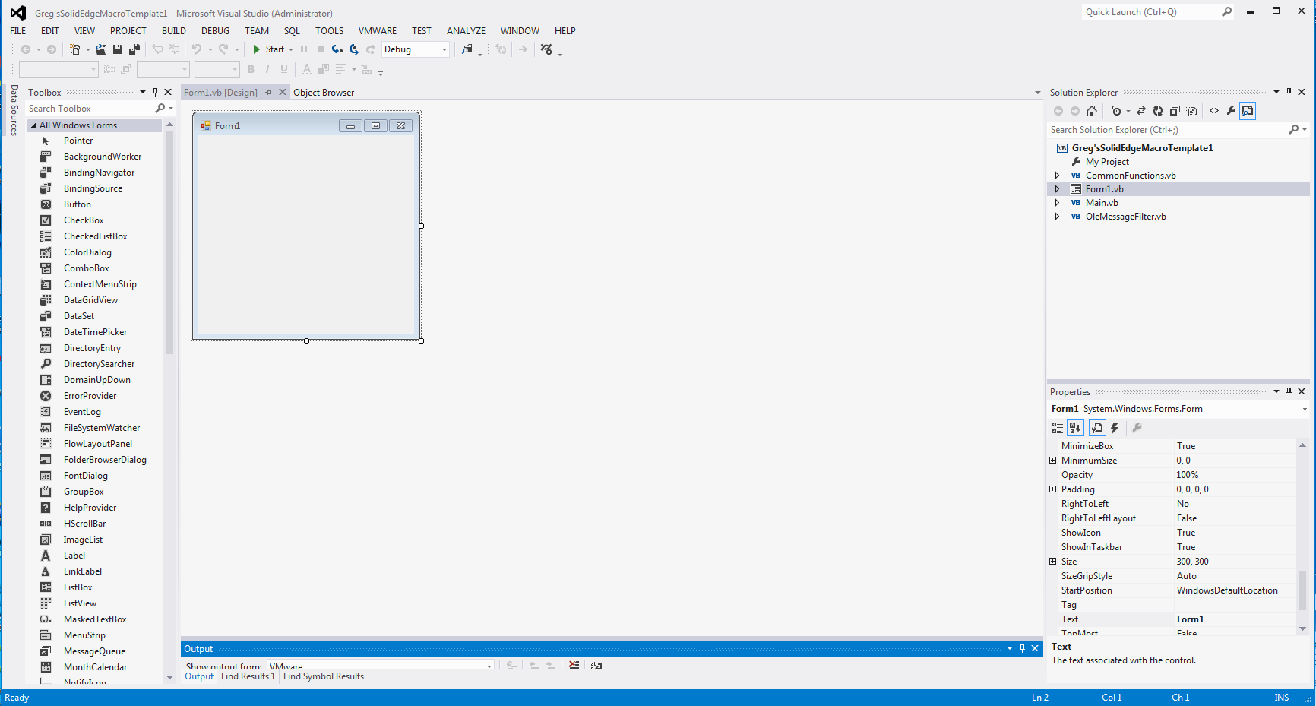
VB 2012
Visual Basic 2012 IDE comprises a few windows, the Form window , the Solution Explorer window and the Properties window . It also consists of a toolbox contains many useful controls that allows a programmer to develop his or her VB programs.

Slide 6
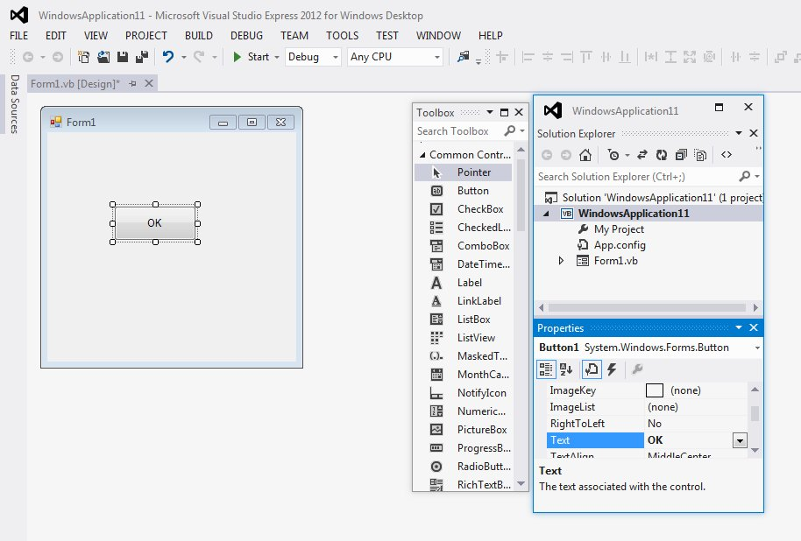
VB 2012
To create your first program in Visual Basic 2012, drag the button control into the form, and change its default Text Button1 to OK in the properties window, the word OK will appear on the button in the form, as shown below:

Slide 7
VB 2012
Visual Basic 2012 is an object oriented and event driven programming language. In fact, all windows applications are event driven. Event driven means the user will decide what to do with the program, whether he or she wants to click the command button, enter text in a text box, or close the application and etc. An event is related to an object, it is an incident that happens to the object due to the action of the user , such as a click or pressing a key on the keyboard.
To start writing code in Visual Basic 2012, click on any part of the form to go into the code window as shown in Figure 5.2. This is the structure of an event procedure. In this case, the event procedure is to load Form1 and it starts with Private Sub and end with End Sub. This procedure includes the Form1 class and the event Load, and they are bind together with an underscore, i.e. Form_Load. It does nothing other than loading an empty form.

Slide 8
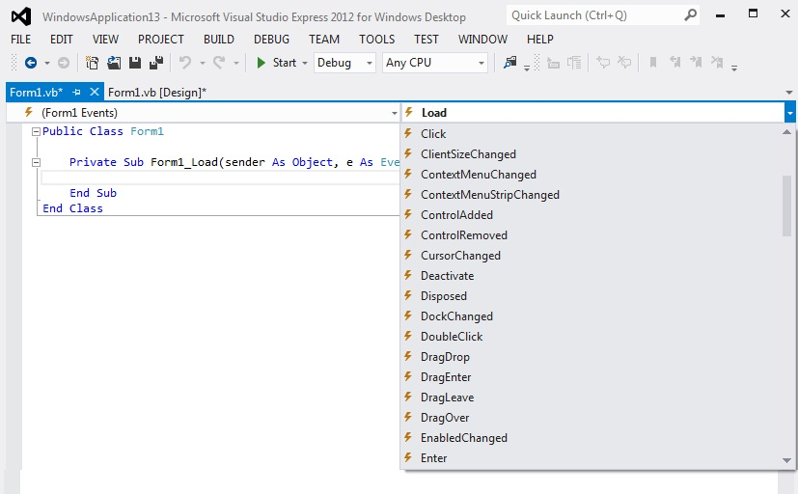
VB 2012
Every VB 2012 object has events, below you can see the event set for a windows form:

Slide 9
VB 2012
Now you are ready to write the code for the event procedure so that it will do something more than loading a blank form. The code must be entered between Private Sub…….End Sub.
Let’s enter the following code :
Public Class Form1
Private Sub Form1_Load(ByVal sender As System.Object, ByVal e As System.EventArgs) Handles MyBase.Load
Me.Text = “My First VB2012 Program”
Me.ForeColor = Color.LightGoldenrodYellow
Me.BackColor = Color.RoyalBlue
End Sub
End Classs

Slide 10
Create a Windows Forms Application Project
To create a Windows Forms application project
On the File menu, choose New Project.
If you’re not using an Express version of Visual Studio, choose Visual Basic in the Installed Templates list.
Choose the Windows Forms Application icon, name the form “My First Application”, and then choose the OK button.
Visual Studio creates the solution.
On the File menu, choose Save All.
As an alternative, choose the Save All button on the toolbar to specify path and project name.
Make sure that the project is saved in a folder under your My Documents folder, verify that the Create Directory for Solution check box is selected, and then choose the Save button. Visual Studio automatically fills in the folder name and the project name and then saves the project in your projects folder.

Slide 11

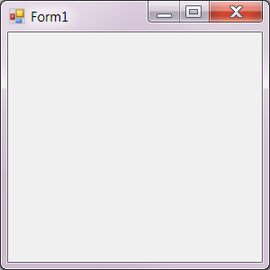
Run Your Program
Press the F5 key or click the Start Debugging toolbar button, which appears as follows.
Start Debugging toolbar button
2.The IDE runs your program, and a window appears. The following picture shows the program you just built. The program is running, and you will soon add few controls to it.

Slide 12
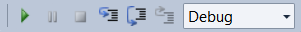
Run Your Program
Press the F5 key or click the Start Debugging toolbar button, which appears as follows.
Go back to the IDE, and look at the new toolbar - Debugging toolbar
Click the square Stop Debugging button or from the Debug menu, click Stop Debugging. The program stops running, and the window closes. You can also just close the open window to stop debugging.
When you run your program from inside the IDE, it's called debugging because you typically do it to track down and fix bugs. It's a real program, and you can run it just like you run any other program.

Slide 13
Set Form Properties
Use the Properties window to change the way your form looks.
Be sure you're looking at Windows Forms Designer. In the IDE, click the Form1.vb [Design] tab (or the Form1.vb [Design] tab in Visual Basic).
Click anywhere inside the form to select it. Look at the Properties window, which should now be showing the properties for the form. Forms have various properties. For example, you can set the foreground and background color, title text that appears at the top of the form, size of the form, and other properties.
When you run your program from inside the IDE, it's called debugging because you typically do it to track down and fix bugs. It's a real program, and you can run it just like you run any other program.

Slide 14
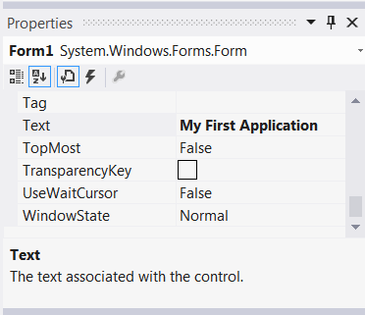
Set Form Properties
After the form is selected, scroll down to the bottom of the Properties window, and find the Text property. Click Text, type Picture Viewer, and then press ENTER. Your form should now have the text Picture Viewer in its title bar, and the Properties window should look like the following picture.
Properties can be ordered by a Categorized or Alphabetical view. You can switch between these two views by using the buttons on the Properties window. In this tutorial, it's easier to find properties through the Alphabetical view.

Slide 15
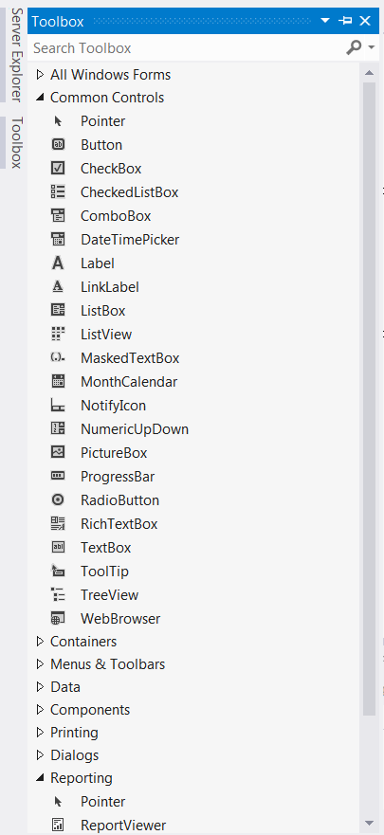
Layout Your Form
Go back to Windows Forms Designer. Click the form's lower-right drag handle, which is the small white square in the lower-right of the form and appears as follows. Drag it to resize the form so the form is wider and a bit taller.
Click the arrow sign next to the Containers group to open it, as shown in the following picture

Slide 16
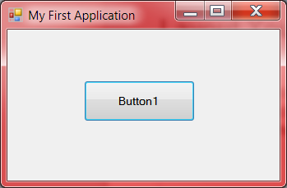
Layout Your Form
You can add controls like buttons, check boxes, and labels to your form. Click on Common Controls and expand it. Now Double-click the “Button” control in the Toolbox. When you do this, the IDE adds a Button control to your form, as shown in the following picture.

Slide 17
Layout Your Form
You can add as many buttons as you want. Every button is suffixed by its index.
Whenever you add new button in your form, you can align it with other controls available on your form.
To change the size of the controls you can just click on it and drag the White colored square in required direction.
To move the button, just click on it and use “Click + Drag” to move the control anywhere on your form.
To rename the button you have to change the “Text” property of the button. Click on the button and then go to “Properties” window to change the “Text” property .
To align the controls, select them and then go to “Format” menu. Format menu has different commands available to Align, Change Size, Horizontal spacing, Vertical Spacing and change order.
You can double click this button in VS IDE to write a code for Button1 Click Event.

Slide 18
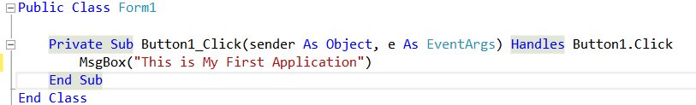
Layout Your Form
You can double click this button in VS IDE to write a code for Button1_Click Event. Write following code for Button1_Click event which will show you Message Box.
Message Box will be shown when you will Run this application. To Run this application use F5 key or use button highlighted below.

Slide 19
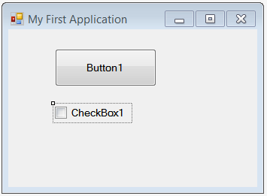
Layout Your Form
Now its time to add CheckBox control to your form. Go to Toolbox and add CheckBox control on your form.
Double click on this CheckBox to write code for the same. Write below code to display message box.

Slide 20
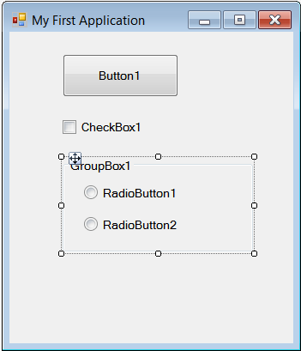
Layout Your Form
How to add “RadioButton” control to your form? To add a “RadioButton” control you must use “GroupBox” control first. Go to Toolbox and add “GroupBox” control first and then add as many “RadioButton” Controls as you want. “RadioButton” contorls are groupped because application user will be given a chance to select only one option at a time.
Double click on this “RadioButton” to write code for the same. Write below code to display message box.

Slide 21
Name Your Button Controls
To name controls on your form
There are four controls on your form, and the IDE named them button1, CheckBox1, RadioButton1, and RadioButton2. By just looking at their current names, you don't know which control has which functionality. That's why naming your controls is always helpful.
Click the Close Button1. (If you still have all the controls selected, press the ESC key to cancel the selection.) Scroll in the Properties window until you see the (Name) property. (The (Name) property is near the top when the properties are alphabetical.) Change the name to closeButton, as shown in the following picture.
If you try changing the name of your button to close Button, with a space between the words close and Button, the IDE displays an error message: "Property value is not valid." Spaces (and a few other characters) are not allowed in control names.

Slide 22
Name Your Button Controls
Rename the other three buttons to backgroundButton, clearButton, and showButton. You can verify the names by clicking the control selector drop-down list in the Properties window. The new button names appear.

Slide 23
Rearranging the Controls
To name controls on your form
Now lets rearrange these all controls.
There are four controls on your form, and the IDE named them button1, CheckBox1, RadioButton1, and RadioButton2. By just looking at their current names, you don't know which control has which functionality. That's why naming your controls is always helpful.
Click the Button1. (If you still have all the controls selected, press the ESC key to cancel the selection.) Scroll in the Properties window until you see the (Name) property. (The (Name) property is near the top when the properties are alphabetical.) Name each control as shown below.
If you try changing the name of your button to close Button, with a space between the words close and Button, the IDE displays an error message: "Property value is not valid." Spaces (and a few other characters) are not allowed in control names.

Slide 24
Rearranging the Controls
Current Name of Control | New Name of Control | Text for the control
CheckBox1 | chkboxNewSession | Start New Session
GroupBox1 | groupSETemplateOpt | Solid Edge Template Options
RadioButton1 | radbuttonAssembly | Assembly
RadioButton12 | radbuttonPart | Part
Button1 | btnStartSE | Start Solid Edge

Slide 25
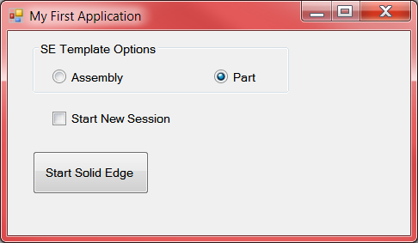
Write Code for the Show a Picture Button Event Handler
To run your program press F5. Now the Form should look like this….
We will be adding few more lines of code in next session.

Slide 26
Error Handling
Error handling is an essential procedure in Visual Basic 2012 programming because it helps make a program error-free. Error-free code not only enables the programs to run smoothly and efficiently, it can also prevent all sorts of problems from happening like program crashes or system hangs.
Therefore a good programmer should be more alert to the parts of program that could trigger errors and should write errors handling code to help the user in managing the errors. Writing errors handling code is a good practice for Visual Basic 2012 programmers, so do not try to finish a program fast by omitting the errors handling code. However, there should not be too many errors handling code in the program as it create problems for the programmer to maintain and troubleshoot the program later.

Slide 27
Error Handling
Using On Error GoTo Syntax
Visual Basic 2012 still supports the VB6 errors handling syntax, that is the On Error GoTo program_label structure. Although it has a more advanced error handling method, we shall deal with that later.We shall now learn how to write errors handling code in Visual Basic 2012. The syntax for errors handling is
On Error GoTo program_label
where program_label is the section of code that is designed by the programmer to handle the error committed by the user. Once an error is detected, the program will jump to the program_label section for error handling.

Slide 28
Example
Public Class Form1
Private Sub CmdCalculate_Click(ByVal sender As System.Object, ByVal e As System.EventArgs) Handles CmdCalculate.Click
Lbl_ErrorMsg.Visible = False
Dim firstNum, secondNum As Double
On Error GoTo error_handler
firstNum = Txt_FirstNumber.Text
secondNum = Txt_SecondNumber.Text
Lbl_Answer.Text = firstNum / secondNum
Exit Sub ‘To prevent error handling even the inputs are valid
error_handler:
Lbl_Answer.Text = “Error”
Lbl_ErrorMsg.Visible = True
Lbl_ErrorMsg.Text = ” One of the entries is not a number! Try again!”
End Sub
End Class

Slide 29
Error Handling
VB2012 has adopted a new approach in handling errors, or rather exceptions handling. It is supposed to be more efficient than the old On Error Goto method, where it can handles various types of errors within the Try…Catch…End Try Finally structure.
The structure looks like this:
Try
statements
Catch exception_variable as Exception
statements to deal with exceptions
End Try
Statements
Finally

Slide 30
Contact
Greg Chasteen
Technical Account Manager
Siemens PLM Software
675 Discovery Drive, Suite 100
Huntsville, Al 35806
Office: (256) 705-2621
Cell:(256) 479-9055
E-mail:
chasteen.gregory@siemens.com

